Slide 1
Different types of data analytics
Kaustubh Kulkarni

Slide 2
Different types of data analytics:
Descriptive analytics,
Diagnostics Analytics,
Predictive analytics,
Prescriptive analytics

Slide 3
Four types
Descriptive analytics: What happened?
Diagnostic analytics: Why did this happen?
Predictive analytics: Based on the past data, what could happen?
Prescriptive analytics: Taking the other three analytics together as an aggregate, what can we do about it?

Slide 4
What Does Descriptive Analytics Tell Us?
It gives businesses essential information about how it’s doing, where it’s going, and how it’s stacking up against the competition.
The company’s current performance: Descriptive analytics helps businesses keep track of critical metrics involving individuals, groups and teams, and the company.
For instance, descriptive analytics can show how a specific sales representative is doing this quarter or which of the representative’s products sells the most.

Slide 5
Continued…
The business’s historical trends: Descriptive analytics gathers information over long periods, and that accumulated information can be used to track the company's progress by comparing the metrics for different periods.
For example, the corporate bean counters can track sales or expenses by comparing the results of various quarters, calculating revenue growth by percentages, and rendering the results on easy-to-read charts.

Slide 6


Slide 7
Continued…
The company’s strong and weak points: Descriptive analytics gives professionals the tools to compare the performances of various business groups using metrics like employee-generated revenue or expenses as a percentage of revenue.
It will also compare these results with known industry averages or published results from other businesses.
These comparisons help companies see where they’re doing well and where they need to improve.

Slide 8
How Does Descriptive Analytics Work?
Descriptive analytics breaks down into five steps, including:
1. State the Business Metrics
2. Identify the Data Required
3. Extract and Prepare the Data
4. Analyze the Data
5. Present the Data
Notes:
Descriptive analytics breaks down into five steps, including:
1. State the Business Metrics
For starters, the business must identify the metrics that it wants to generate based on the essential business goals of each group within the company or the company's overall goals. For instance, a company emphasizing growth may emphasize measuring quarterly revenue increases. At the same time, the company's accounts receivable department might monitor great days' sales and other metrics that show how much time it takes to collect money from their customers.
2. Identify the Data Required
Next, the company must find the data needed to generate the desired metrics. This task is a potential challenge since the relevant data may be scattered across many files and applications. However, companies that employ an Enterprise Resource Planning (ERP) system may have an easier time because they will already have most or all the needed data in their systems' databases. Furthermore, some metrics may also need data from external sources, like e-commerce websites, industry benchmarking databases, or social media platforms.
3. Extract and Prepare the Data
Extracting, combining, and preparing the relevant data for analysis is potentially time-consuming if the needed analysis data originates from multiple sources. However, this is a crucial step to ensure accuracy. Furthermore, this may involve data cleansing to eliminate inconsistencies and mistakes in the data, a reasonable effort considering the information coming from an eclectic group of sources and rendering data into a suitable format for analysis tools. Advanced data analytics types use a process known as data modeling, a framework residing within information systems to help prepare, arrange, and organize the company's information. Data modeling defines and formats complex data, turning it into a usable, actionable resource.
4. Analyze the Data
Companies have various tools at their disposal to apply descriptive analytics, ranging from business intelligence (BI) software to spreadsheets such as ones found in Excel. Descriptive analytics usually involves using fundamental mathematical operations to one or more of the variables. For instance, a sales manager might like to monitor the average sales revenue or the monthly revenue from either established or recently acquired customers.
5. Present the Data
Once business analysts have gone through the necessary steps, all that's left is presenting the data. First, however, the information must be presented so that everyone can understand it, from stakeholders to finance specialists. Stakeholders usually appreciate seeing the report in compelling visual forms, like bar charts, pie charts, or line graphs. Visible data is easier to grasp. Finance specialists on the other hand, may want the information presented through numbers and tables.

Slide 9
1. State the Business Metrics
For starters, the business must identify the metrics that it wants to generate based on the essential business goals of each group within the company or the company's overall goals.
For instance, a company emphasizing growth may emphasize measuring quarterly revenue increases.
At the same time, the company's accounts receivable department might monitor great days' sales and other metrics that show how much time it takes to collect money from their customers.

Slide 10
2. Identify the Data Required
Next, the company must find the data needed to generate the desired metrics.
This task is a potential challenge since the relevant data may be scattered across many files and applications.
However, companies that employ an Enterprise Resource Planning (ERP) system may have an easier time because they will already have most or all the needed data in their systems' databases.
Furthermore, some metrics may also need data from external sources, like e-commerce websites, industry benchmarking databases, or social media platforms.

Slide 11
3. Extract and Prepare the Data
Extracting, combining, and preparing the relevant data for analysis is potentially time-consuming if the needed analysis data originates from multiple sources.
Furthermore, this may involve data cleansing to eliminate inconsistencies and mistakes in the data, a reasonable effort considering the information coming from an eclectic group of sources and rendering data into a suitable format for analysis tools.
Advanced data analytics types use a process known as data modelling, a framework residing within information systems to help prepare, arrange, and organize the company's information.
Data modelling defines and formats complex data, turning it into a usable, actionable resource.

Slide 12
4. Analyze the Data
Companies have various tools at their disposal to apply descriptive analytics, ranging from business intelligence (BI) software to spreadsheets such as ones found in Excel.
Descriptive analytics usually involves using fundamental mathematical operations to one or more of the variables.
For instance, a sales manager might like to monitor the average sales revenue or the monthly revenue from either established or recently acquired customers.

Slide 13
5. Present the Data
Once business analysts have gone through the necessary steps, all that's left is presenting the data.
First, however, the information must be presented so that everyone can understand it, from stakeholders to finance specialists.
Stakeholders usually appreciate seeing the report in compelling visual forms, like bar charts, pie charts, or line graphs.
Visible data is easier to grasp.
Finance specialists on the other hand, may want the information presented through numbers and tables.

Slide 14
Advantages of Descriptive Analytics
It’s easy to do: Descriptive analysis doesn’t require great expertise or experience in statistical methods or analytics.
There are a lot of tools available: There is a cornucopia of analytics tools available to choose from, products that do most of the heavy lifting. Come to think of it, that helps explain why it’s easy to perform descriptive analytics!
It answers the most common business performance questions: Most stakeholders and salespeople want to know things like "How are we doing?" or "What should we be doing differently?" Descriptive analytics provides the data needed to answer those questions efficiently, no matter when or how often they're asked

Slide 15
Drawbacks
It’s limited to simple analysis: Descriptive analysis examines the relationship between a handful of variables, and that’s all.
It tells you what, but not why: Descriptive analysis reports events as they happened, not why they happened or what could possibly happen next.

Slide 16
Descriptive vs. Predictive vs. Prescriptive Analytics
 | Descriptive Analysis | Predictive Analysis | Prescriptive Analysis
Summary | What happened? | What’s going to happen? | What should happen?
Function | It uses data mining and data aggregation to discover historical data. | It looks at historical data and analyzes past data trends to predict what could happen. | It takes the conclusions gleaned from descriptive and predictive analysis and recommends the best future course of action.

Slide 17
 | Descriptive Analysis | Predictive Analysis | Prescriptive Analysis
Pros | It’s easy to employ in daily operations. Little experience is needed. | It’s a valuable forecasting tool. | It offers critical insights into making the best, most informed decisions.
Cons | It offers a limited view, and doesn't go beyond the data’s surface. | It needs lots of historical data to work. It will never be 100% accurate. | It requires a lot of past data and often cannot account for all possible variables.

Slide 18
Diagnostics Analytics
Involves drilling deeper into data to identify not only what has occurred, but why.
This focus on cause and effect is why diagnostic analytics is sometimes known as root cause analysis.
Notes:
https://careerfoundry.com/en/blog/data-analytics/diagnostic-analytics/

Slide 19
Diagnostic analytics is similar to descriptive analytics in that it also uses historical data. However, its unique feature is that it aims to identify and explain anomalies and outliers.
For instance, perhaps a fashion brand sees an unexpected surge in profits. By applying diagnostic analytics, the company can develop and test various hypotheses about why that has happened.
Perhaps one of their clothing ranges has been promoted by a celebrity influencer, or maybe it has appeared on a Netflix series.
By sourcing and analyzing additional data, they can identify the most likely cause for the profit surge, in turn, informing their future strategy (for instance, by actively pursuing product placement deals with Netflix).

Slide 20
Diagnostic analytics employs various techniques, ranging from probability theory to regression analysis, clustering analysis, filtering, time-series analysis, and more.
Notes:
It’s not just about statistics, though. It involves thinking laterally, considering external factors that might be impacting the patterns in your data, finding additional sources to help you build a broader picture, and then checking these conclusions against the original dataset.

Slide 21
How is diagnostic analytics used?
Sales teams—to determine why a company’s profits are dropping or growing.
Marketing teams—to figure out why a website has seen a traffic increase.
IT—to diagnose technical problems within a company’s digital infrastructure.
HR—to understand the factors contributing to why employees may leave a company.
Big pharma—to evaluate the effectiveness of different drugs.
Hospitals—to understand why patients are admitted for particular ailments.

Slide 22
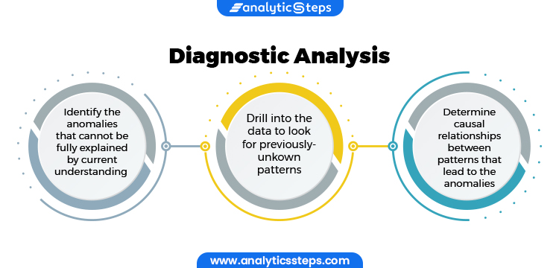

Slide 23
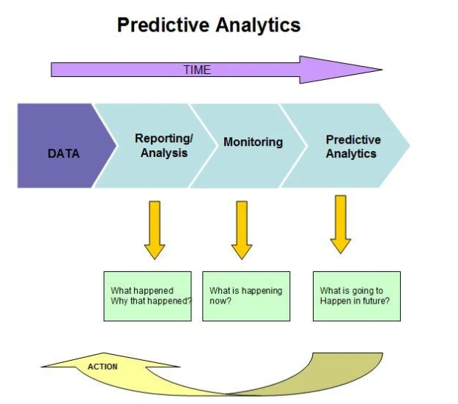

Slide 24
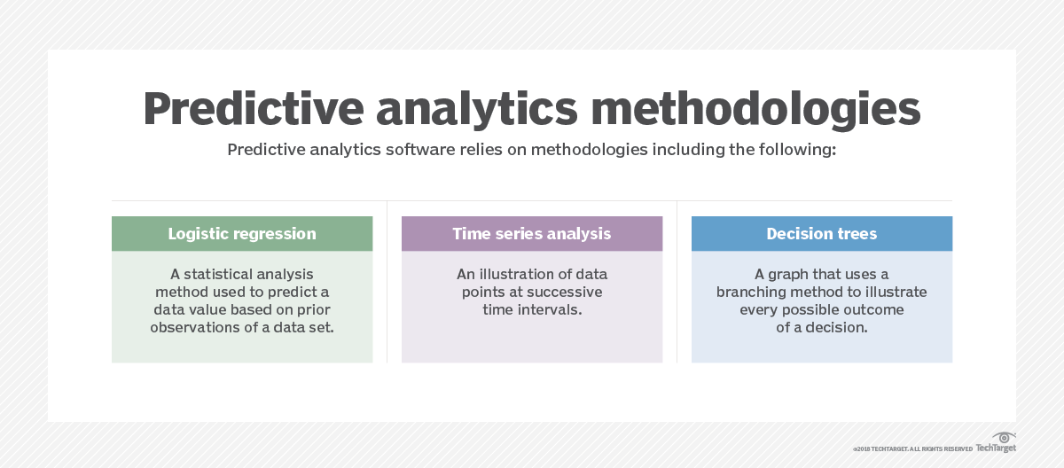

Slide 25
How to develop a predictive analytics process
Define the requirements. Understand the business problem you're trying to solve. Is it managing inventory? Reducing fraud? Predicting sales? A business user or subject matter expert generally takes charge of this first step.
Explore the data. Identify the data that informs the problem you're trying to solve.

Slide 26
How to develop a predictive analytics process
Develop the model. A data scientist can help figure out which predictive models are best suited to solving the problem.
Deploy the model. Once the model is approved by the data scientist, a data engineer determines how best to retrieve, clean and transform the required raw data.
Validate the results.

Slide 27
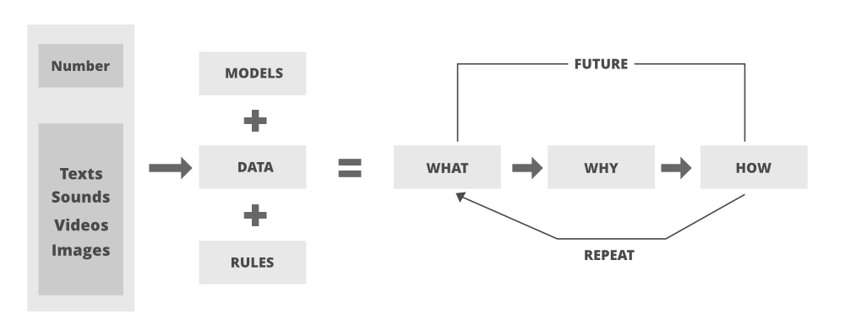

Slide 28
A complete example

Slide 29
Descriptive analytics
Descriptive analytics answers the question, “What happened?”
For example, imagine you’re analyzing your company’s data and find there’s a seasonal surge in sales for one of your products: a video game console.
Here, descriptive analytics can tell you, “This video game console experiences an increase in sales in October, November, and early December each year.”

Slide 30
Diagnostic analytics
Diagnostic analytics addresses the next logical question, “Why did this happen?”
Taking the analysis a step further, this type includes comparing coexisting trends or movement, uncovering correlations between variables, and determining causal relationships where possible.
Continuing the aforementioned example, you may dig into video game console users’ demographic data and find that they’re between the ages of eight and 18.
The customers, however, tend to be between the ages of 35 and 55.
Analysis of customer survey data reveals that one primary motivator for customers to purchase the video game console is to gift it to their children.
The spike in sales in the fall and early winter months may be due to the holidays that include gift-giving.

Slide 31
Predictive analytics
Predictive analytics is used to make predictions about future trends or events and answers the question, “What might happen in the future?”
By analyzing historical data in tandem with industry trends, you can make informed predictions about what the future could hold for your company.
For instance, knowing that video game console sales have spiked in October, November, and early December every year for the past decade provides you with ample data to predict that the same trend will occur next year.
Backed by upward trends in the video game industry as a whole, this is a reasonable prediction to make.

Slide 32
Prescriptive analytics
Finally, prescriptive analytics answers the question, “What should we do next?”
What should your team decide to do given the predicted trend in seasonality due to winter gift-giving?
Perhaps you decide to run an A/B test with two ads: one that caters to product end-users (children) and one targeted to customers (their parents).
The data from that test can inform how to capitalize on the seasonal spike and its supposed cause even further.
Or, maybe you decide to increase marketing efforts in September with holiday-themed messaging to try to extend the spike into another month.
While manual prescriptive analysis is doable and accessible, machine-learning algorithms are often employed to help parse through large volumes of data to recommend the optimal next step.

Slide 33
Questions ?

